Slide 1

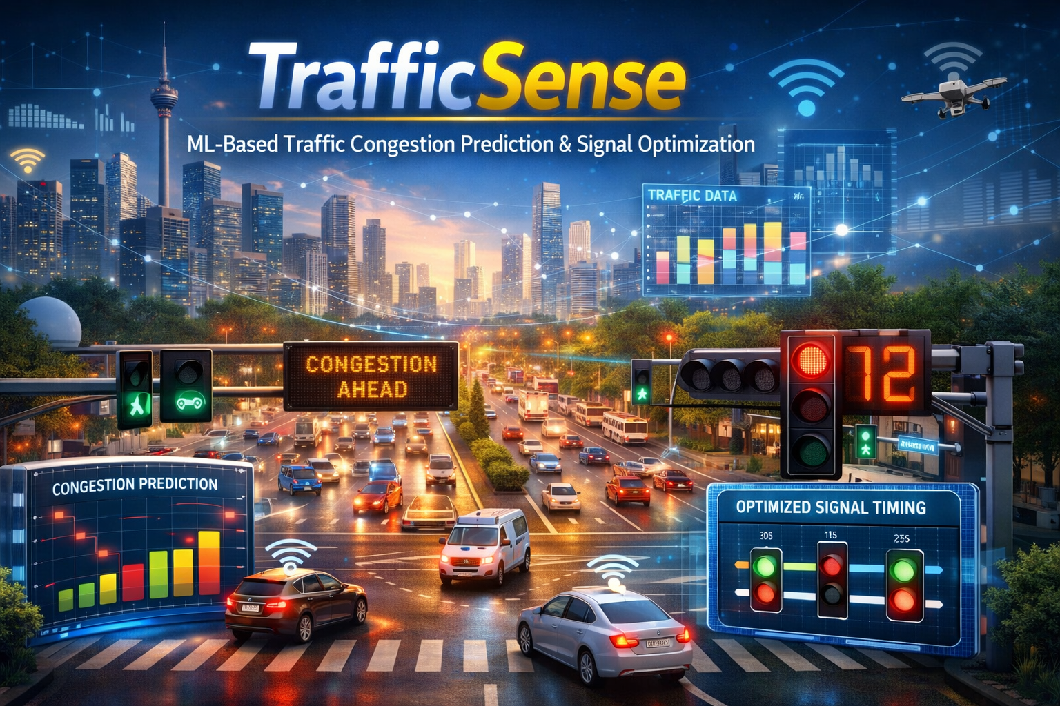
PANIMALAR ENGINEERING COLLEGE
IDEATHON 2022
Team Name: AKAKN
Akilan M
III CSE A
ak.akilan.smart22@gmail.com
Traffic Sense

Slide 2
Abstract:
Urban traffic congestion causes major losses in travel time, fuel consumption, and productivity, while also increasing accident risk and emissions. Most existing traffic signal systems rely on fixed-time schedules or simple rule-based logic that does not adapt well to real-world variability such as rush hours, road incidents, weather, school/office timings, or public events. This ideathon project proposes TrafficSense, a machine learning–driven Smart City solution that predicts near-term congestion and recommends adaptive signal timing to reduce queue buildup at intersections.
TrafficSense is designed as a two-stage pipeline. In the prediction stage, the system forecasts short-horizon congestion levels (e.g., 5–15 minutes ahead) for road segments and intersections using supervised learning. The model consumes features from historical traffic patterns and live signals such as timestamp, day type (weekday/holiday), intersection ID, lane/road attributes, recent average speed, vehicle counts, queue length estimates, and optional external factors like event schedules or weather. The output is a congestion score or predicted traffic density for each approach (incoming road) at an intersection.
In the optimization stage, TrafficSense converts predictions into actionable control decisions: recommended green-split ratios, cycle length adjustments, and phase scheduling under operational constraints. Constraints include minimum/maximum green times, pedestrian crossing intervals, fairness across directions (prevent starvation), emergency vehicle priority, and safety rules. Rather than directly controlling signals without safeguards, the proposed system acts as a decision-support module that suggests timing plans, allowing a traffic operator or a rule-based safety layer to validate and apply changes.
The project emphasizes practical engineering considerations: cold-start handling for new intersections, robustness to missing/noisy sensor inputs, and scalable deployment where inference must run in near real time. Model performance can be evaluated using forecasting metrics such as MAE/RMSE for speed/flow prediction and classification metrics(precision/recall) if congestion is framed as discrete levels. System-level evaluation focuses on traffic outcomes such as reduced queue length, fewer stops, smoother average travel time, and improved throughput during peak hours.
TrafficSense’s ideathon deliverable is a complete conceptual framework including architecture, data plan, feature definitions, model choices (baseline regression/gradient boosting with room for LSTM/temporal models), constraint-aware optimization logic, and a demo narrative illustrating how adaptive recommendations respond to changing traffic conditions. This solution targets a high-impact Smart City problem and demonstrates end-to-end ML system thinking from data to deployment.

Slide 3
Problem Statement:
Urban traffic congestion is highly dynamic, varying minute-to-minute due to time-of-day patterns, incidents, weather, and local events. Most intersections still operate on fixed-time or minimally adaptive signal plans that cannot respond to real-time demand, causing queue spillback, wasted green time, and corridor-level gridlock. Cities need a system that can forecast congestion in the next few minutes (short-horizon) and translate those predictions into safe, constraint-aware signal timing recommendations. The solution must respect real-world operational constraints such as minimum/maximum green times, pedestrian crossing phases, coordination across adjacent signals, and fairness across approaches (no starvation), while remaining robust to noisy or missing sensor inputs.

Slide 4
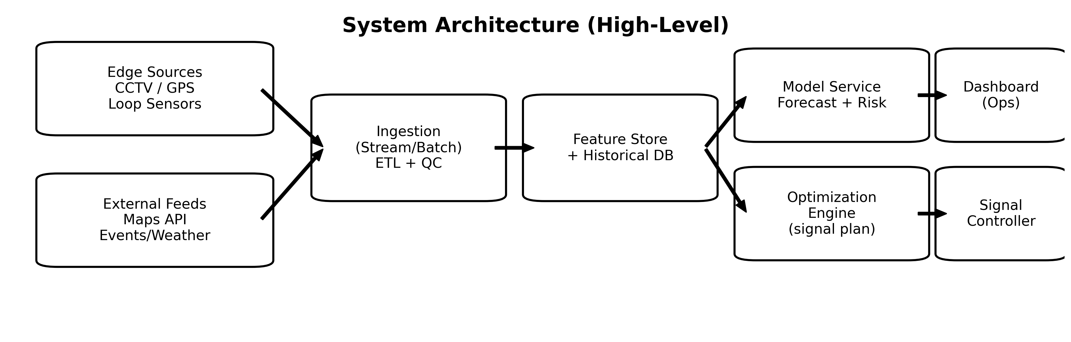
Architecture and functionalities
• Ingest traffic feeds (CCTV / GPS / maps) + context (events, weather).
• Engineer features: time-window stats, speed/volume trends, road attributes.
• Forecast congestion risk per segment/intersection (5–15 min horizon).
• Optimize signal plans with safety and operational constraints.
• Expose recommendations via dashboard + optional controller integration.
ARCHITECTURE DIAGRAM

Slide 5
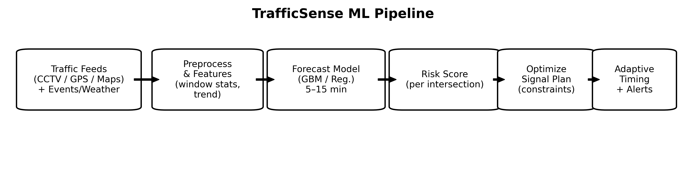
Working of TrafficSense
1) Collect multi-source traffic signals + context features.
2) Clean + aggregate into rolling time windows.
3) Predict near-future congestion (risk score) per intersection.
4) Generate signal timing recommendations with constraints.
5) Display heatmap/alerts; optionally push plan to controller.

Slide 6
Evaluation Metrices
Forecasting Metrics (ML) • MAE / RMSE for speed or volume prediction
• Precision/Recall for “congestion event” classification
• Time-to-detect sudden congestion spikes
Operational Metrics (Traffic)
• Average delay / queue length (simulation or historical replay)
• Throughput at intersections (vehicles per cycle)
• Fairness constraints respected (min green, pedestrians, emergency priority)

Slide 7
Benefits of Traffic Sense
Proactive congestion control: Predicts near-term congestion (5–15 min) so mitigation happens before queues become severe.
Improved intersection performance: Reduces average waiting time and stop-and-go behavior by allocating green time to where demand is rising.
Incident & event awareness: Detects abnormal spikes (crashes, road closures, events) and triggers alerts with recommended response timing plans.
Safety-first actuation: Generates constraint-aware recommendations (pedestrian phases, min/max green, fairness) to prevent unsafe or unstable timing changes.
Emergency priority support (optional): Enables preemption/priority routing logic for ambulances/fire services without breaking corridor coordination.
Scalable deployment: Start with a single corridor/intersection cluster, then expand city-wide as more data sources (CCTV counts, loop detectors, GPS probes) become available.
Sustainability & cost impact: Smoother flow reduces fuel waste and emissions, improving quality of life and commuter productivity.

